Slide 1
NBA Rookies Prediction
Jisun Lee, Yi Lee

Slide 2
Content
Introduction of Data
Mining Pipeline
Data Preprocessing
Attribute Selection
Data Split
Classification Algorithms
Best Model

Slide 3
Introduction of Data
https://data.world/exercises/logistic-regression-exercise-1

Slide 4
Description of The Dataset
Name: Name
GP: Games Played
MIN: MInutes Played
PTS: Points Per Game
FGM: Field Goals Made
FGA: Field Goals Attempts
FG%: Field Goals Percentage
3PM: 3 Point Made
3PA: 3 Point Attempts
3P%: 3 Point Percentage
FTM: Free Throw Made
FTA: Free Throw Attempts
FT%: Free Throw Percentage
OREB: Offensive Rebounds
DREB: Defensive Rebounds
REB: Rebounds
AST: Assists
STL: Steals
BLK: Blocks
TOV: Turn Overs
TARGET_5Yrs:
If career length >= 5, outcome is 1
If career length < 5, outcomes is 0
The class attribute of the data: TARGET_5Yrs

Slide 5
Mining Pipeline

Slide 6
Mining Pipeline
A1Train
A2Train
Modeling
A3Train
Training Set
Attr. Select
A4Train
A5Train
Input
Processing
Train Test Split
Testing Set
Assessment

Slide 7
Data Preprocessing
With R Programming

Slide 8

Raw Data
Take one row as an example
Name | Brandon Ingram | FTM | 1.6
GP | 36 | FTA | 2.3
MIN | 27.4 | FT% | 69.9
PTS | 7.4 | OREB | 0.7
FGM | 2.6 | DREB | 3.4
FGA | 4.6 | REB | 4.1
FG% | 34.7 | AST | 1.9
3P Made | 0.5 | STL | 0.4
3PA | 2.1 | BLK | 1.4
3P% | 25 | TOV | 1.3
TARGET_5Yrs
0

Slide 9
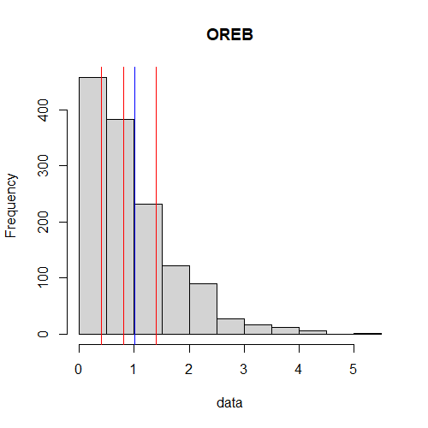
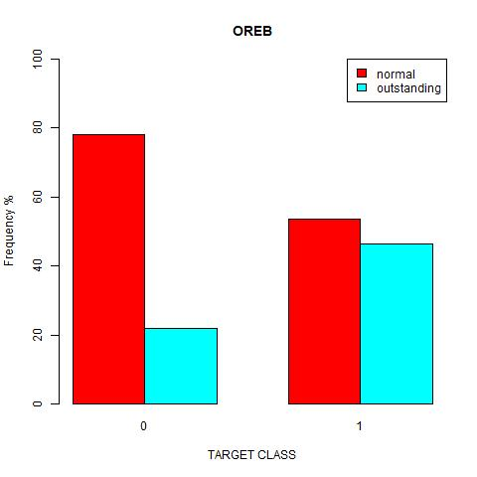
Two Order
Assign | condition
Outstanding 2 | > mean
Normal 1 | Other

Slide 10
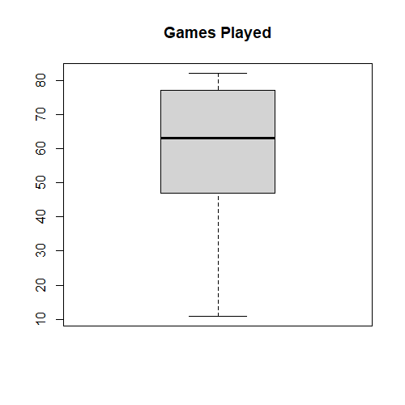
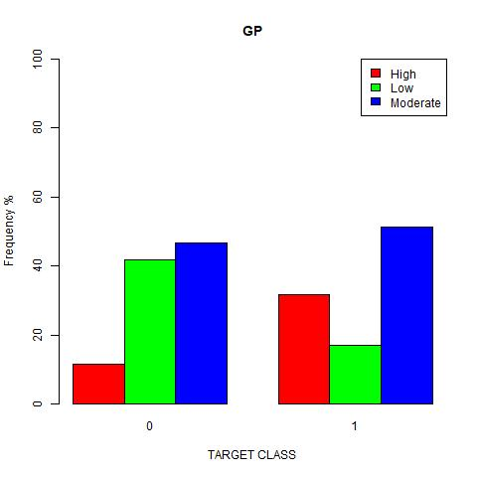
Three Order
Assign | condition
High 3 | > Q3
Moderate 2 | other
Low 1 | <= Q1

Slide 11
New Columns
rule_180 | FG% + 3P% + FT%
STL_TOV_ration | Steal to Turnover ratio
Double_time | Times of achieving double
EEF | The efficiency of a player PTS + REB + AST + BLK - Missed FG - Missed FT - TOV
EEF_GPE | The efficiency per game
EEF_MIN | The efficiency per minute

Slide 12
Raw Data
Take one row as an example
Name | Brandon Ingram | FTM | 2 | rule_180 | 131.7
GP | 3 | FTA | 2 | STL_TOV | 0.5
MIN | 2 | FT% | 1 | double_time | 0
PTS | 6.4 | OREB | 2 | EEF | 10
FGM | 2 | DREB | 2 | EEF_GP | 0.1219
FGA | 4.7 | REB | 4.6 | EEF_MIN | 0.5319
FG% | 2 | AST | 1 | TARGET_5Yrs | 0
3P Made | 1 | STL | 1 | Red = New Columns Yellow = Three Order Blue = Two Order Transparent = Numeric
3PA | 0.1 | BLK | 2
3P% | 2 | TOV | 2

Slide 13
Attribute Selection
With Weka

Slide 14
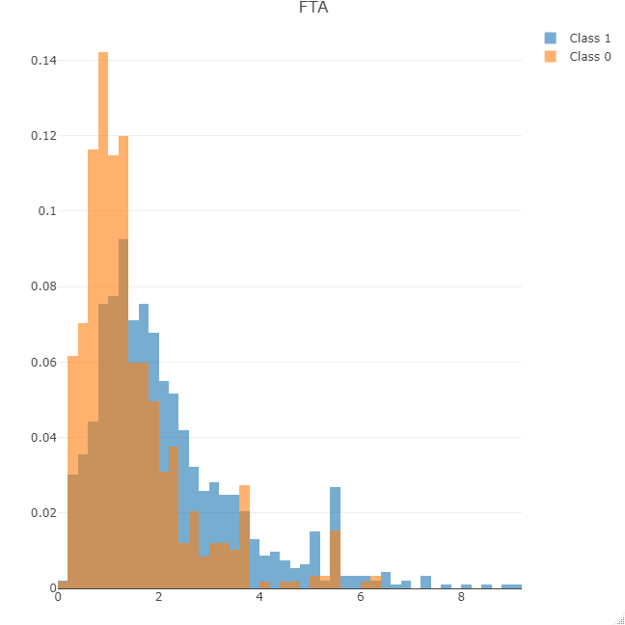

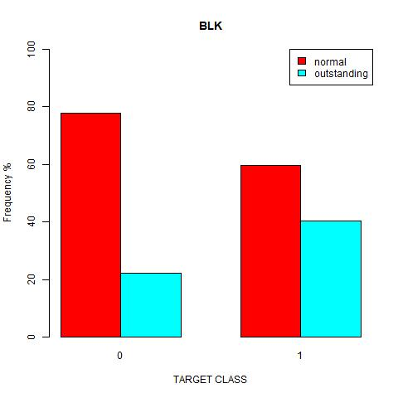
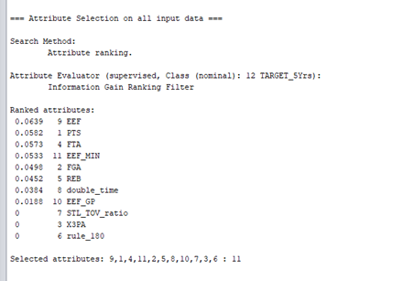
Selection
Three types of data type
Only one selecting algorithm
- InfoGainAttributeEval algorithm from Weka

Slide 15
Selection
Five different groups of attribute selection
Picking from five sub attribute group, rather than picking from all attributes with five algorithms
 | Pick From | Attribute Combination Result
A1 | Numeric Attributes Only | EEF + PTS + FTM + EEF_MIN + FGA
A2 | Three Order Attributes Only | GP + FTM + MIN + FG% + TOV
A3 | Two Order Attributes Only | AST + BLK + DREB + OREB + STL
A4 | All Order Attributes | GP + FTM + OREB + MIN + FG%
A5 | All Attributes | EEF + GP + FTM + PTS + FTA

Slide 16
Data Split
With R Programming

Slide 17
Data Split
First Split: train test split from total data
Randomly Split
Train
 | NO | YES
Testing | 192 (37.3%) | 322 (62.6%) | 514
Training | 392 (39.2%) | 607 (60.7%) | 999
 | 584 | 929 | 1513
66%
Total
34%
Test

Slide 18
Data Split
A1Train
A2Train
A3Train
A4Train
A5Train
Second Split
Split into five subsets based on the attribute groups
Train
66%
Total
Split based on the attribute groups
A1Test
A2Test
A3Test
A4Test
A5Test
34%
Test

Slide 19
Classification Algorithms
With Weka

Slide 20
5 Classification Methods
Naive Bayes
Sophisticated classification
The value of the feature is independent of another feature
Logistic
Estimate the parameters of a logistic model
Finds the probability of success and failure
AdaBoost M1
Boost the performance of decision trees on binary classification
Combine weak base learners; combine strong base learners and provide a more accurate model
Multilayer Perceptron
Utilizes a supervised learning technique
Distinguishes data that is no linearly separable.
Random Forest
The most used supervised learning algorithm
Identify significant information from massive datasets

Slide 21
Best Model
Assessment with Weka

Slide 22
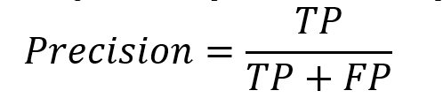
Best Model
Decision Criteria: Precision
Tuples labeled as positive are actually positive
Invest on the right player in the rookie year if he has potential
Best Model: Naïve Bayes with EEF + GP + FTM + PTS + FTA
 | Precision | Class
 | 0.561 | No
 | 0.794 | Yes
Weighted Avg. | 0.700
Assume the team owner cares whether a player could survive after five years of career.

Slide 23
Thank you.

